Slide 1
OS CH1
2026.6.21

Slide 2
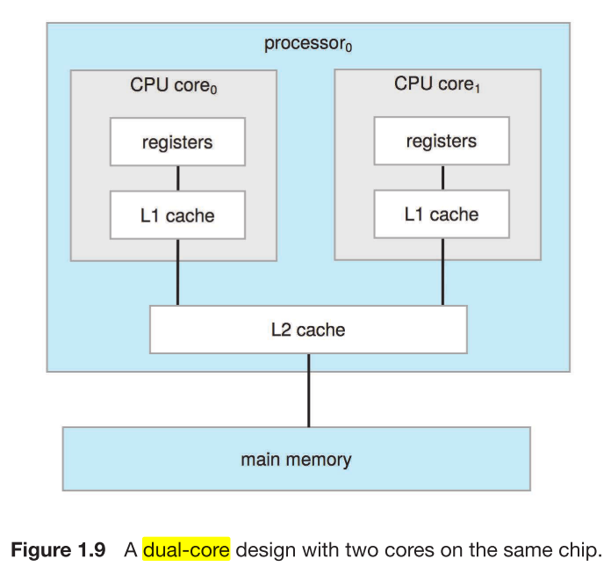
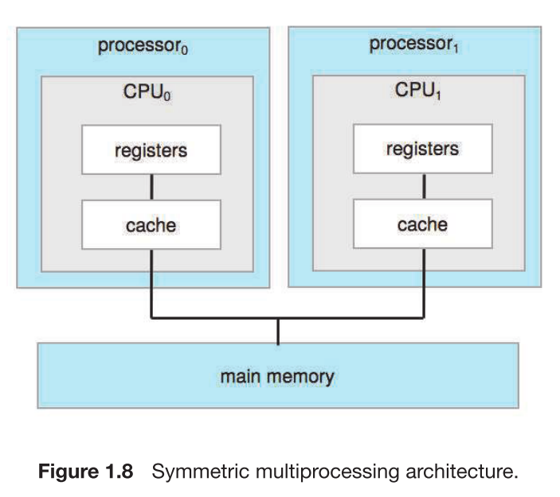
Multi-processor
on-chip communication is faster than between-chip communication

Slide 3
